Slide 1







FILM
GENRES
QUIZ

Slide 2





What type of film is this?
1/14
CORRECT!
action
horror
silent
Click on the right ticket

Slide 3
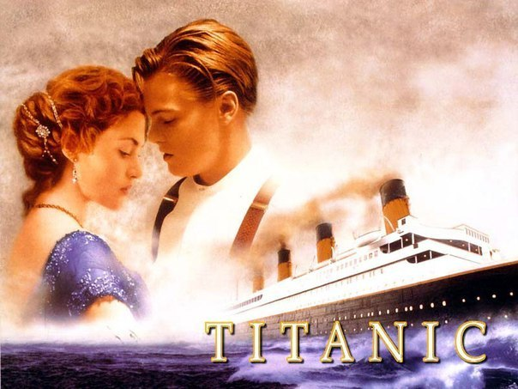
What type of film is this?
2/14
CORRECT!
musical
romance
comedy

Slide 4
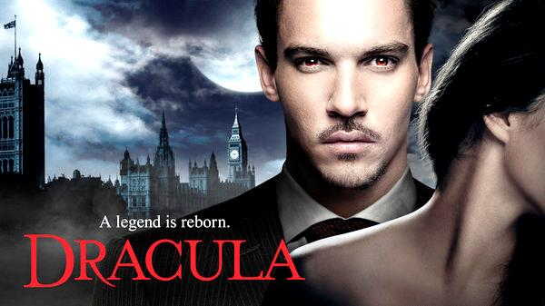
What type of film is this?
3/14
CORRECT!
musical
horror
historical

Slide 5
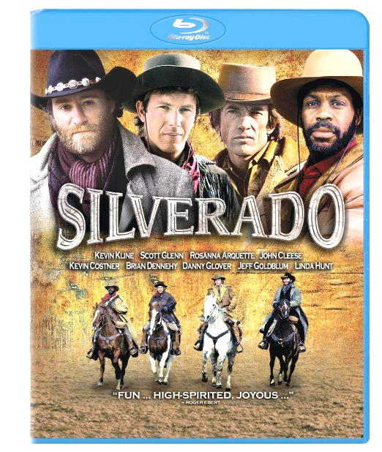
What type of film is this?
4/14
CORRECT!
western
science fiction
drama

Slide 6
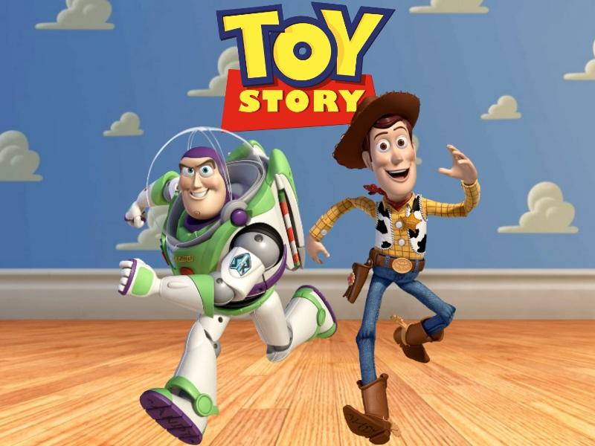
What type of film is this?
5/14
CORRECT!
musical
historical
animated

Slide 7
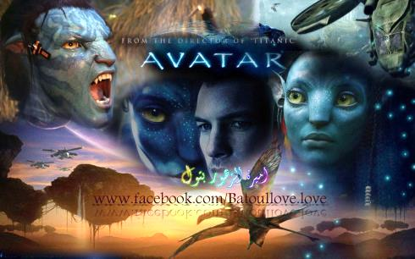
What type of film is this?
6/14
CORRECT!
horror
science fiction
historical

Slide 8

What type of film is this?
7/14
CORRECT!
adventure
science fiction
western

Slide 9
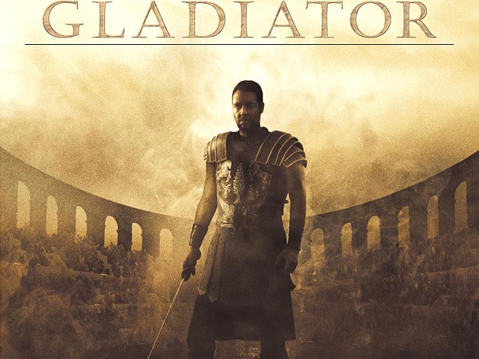
What type of film is this?
8/14
CORRECT!
musical
historical
silent

Slide 10

What type of film is this?
9/14
CORRECT!
comedy
romance
drama

Slide 11

What type of film is this?
10/14
CORRECT!
romance
historical
silent

Slide 12

What type of film is this?
11/14
CORRECT!
action
drama
musical

Slide 13
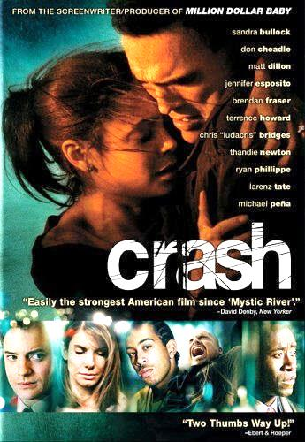
What type of film is this?
12/14
CORRECT!
comedy
science fiction
drama

Slide 14

What type of film is this?
13/14
CORRECT!
war
film noir
western

Slide 15
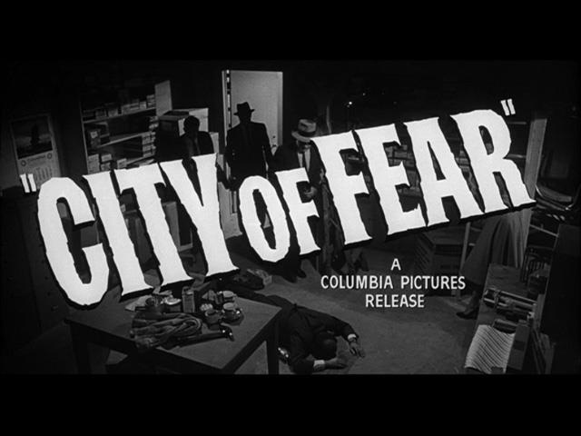
What type of film is this?
14/14
CORRECT!
musical
film noir
war

Slide 16
THE END
EXIT

